Slide 1
Survey of Computer Science Fields Related to the Titles of Master Thesis at Faculty of Mathematics in Belgrade
Dušan Tošić
University of Belgrade, Faculty of mathematics

Slide 2
Agenda
Introduction – master studies in Serbia
Choosing and approving the title of master thesis
General classification of master thesis
Scientific fields
Professional specialization
Number of approved thesis
Typical structure of professional specialized master thesis
Conclusion

Slide 3
1. Introduction
Master studies at Faculty of mathematics in Belgrade are organized according to Bologna declaration.
These studies are similar to the corresponding studies in other European countries.

Slide 4
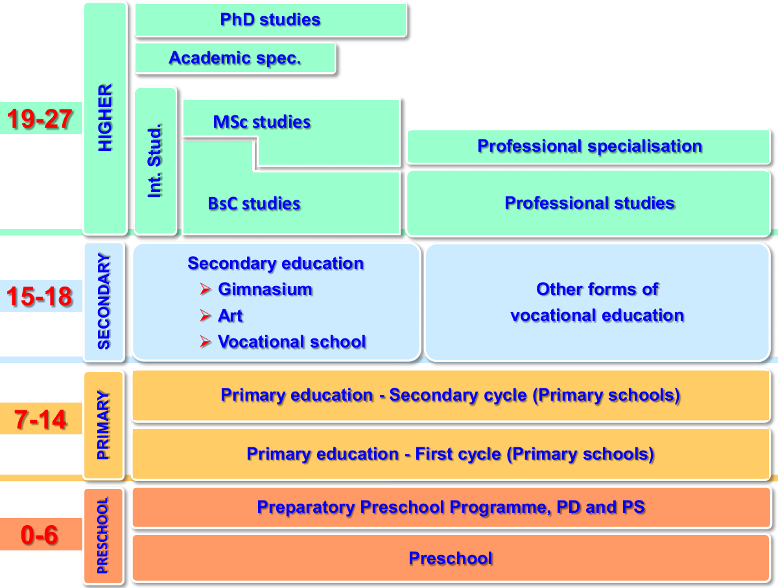
Master studies in Serbia
(R. Mitrović: „Modernization of Higher Education System in Serbia“ )

Slide 5
2. Choosing and approving the title of master thesis
All professors have obligations to propose about 5 titles in beginning of school year. Student can choose free title.
Student can propose the title of master thesis (providing agreement of professor – future adviser for master thesis.)
Each title should be explained in some sentences.
Special commission (composed of 5 professors) analyzes and approve chosen title.
Finally, council should approve proposed title, too.

Slide 6
3. General classification of master thesis
Overall classification:
Scientifically oriented (for research and development)
Professionally oriented (professional specialization)
For some titles it is difficult to make the distinction.

Slide 7
4. Scientific fields
Representation of scientific fields is related to the topics of professors’ research. The titles of master thesis were form:
Soft computing
Machine learning
Automatic theorem proving
Text processing and Semantic web
Algorithms
Bioinformatics
...........

Slide 8
5. Professional specialization
Fields related to professional orientation are more abundant:
Database and information systems
Internet technology and the Web
Programming languages and programming paradigms
Internet protocols
Software development
Java and superstructures (...)
Image processing
Parallel algorithms
Document processing
.NET technology
....

Slide 9
6. Number of approved thesis
At faculty of mathematics in Belgrade students can choose a thesis in mathematics, computer sciences, education and astronomy.
About 160 titles of master thesis from computer sciences have been appproved so far.
(Not all approved thesis are defended – some of them are rejected for plagiarism.)
According to the previous classification, there was approximately:
40 scientifically oriented titles
120 professionally oriented titles.

Slide 10
6.1. Number of titles from scientific fields
Soft computing - 10
Machine learning - 3
Automatic theorem proving - 3
(Serbian)Text processing and Semantic web - 6
Algorithms - 9
Bioinformatics - 3
Others - 6

Slide 11
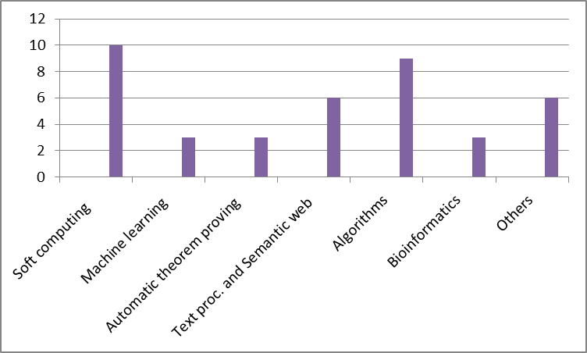

Slide 12
6.2. Number of titles from professional specialization
Database and information systems - 24
Internet technology and Web - 20
Programming languages and programming paradigms -7
Protocols and standards - 5
Software development -10
Java and superstructures - 7
Image processing -3
Parallel algorithms -9
Document processing - 4
.NET technology - 5
Other fields - 26

Slide 13
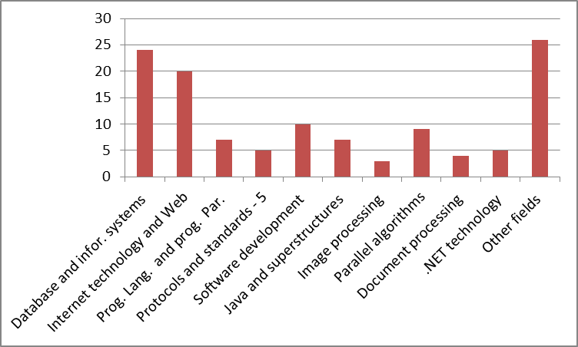

Slide 14
7. Typical structure of professional specialized master thesis
The structure of master thesis depends on the field (there is no template), but usually the following parts are present:
Introduction
Theoretical part
Description of practical work
Conclusion
References

Slide 15
8. Conclusion
The number of scientific oriented titles is lower than the number of professional specialization titles.
The fields form professional specialization are sometimes very close connected and it is difficult to make a precise classification.
The structure of master thesis depends on the field, but inclusion of references is mandatory for all master theses.

Slide 16
Thank you!

